Slide 1
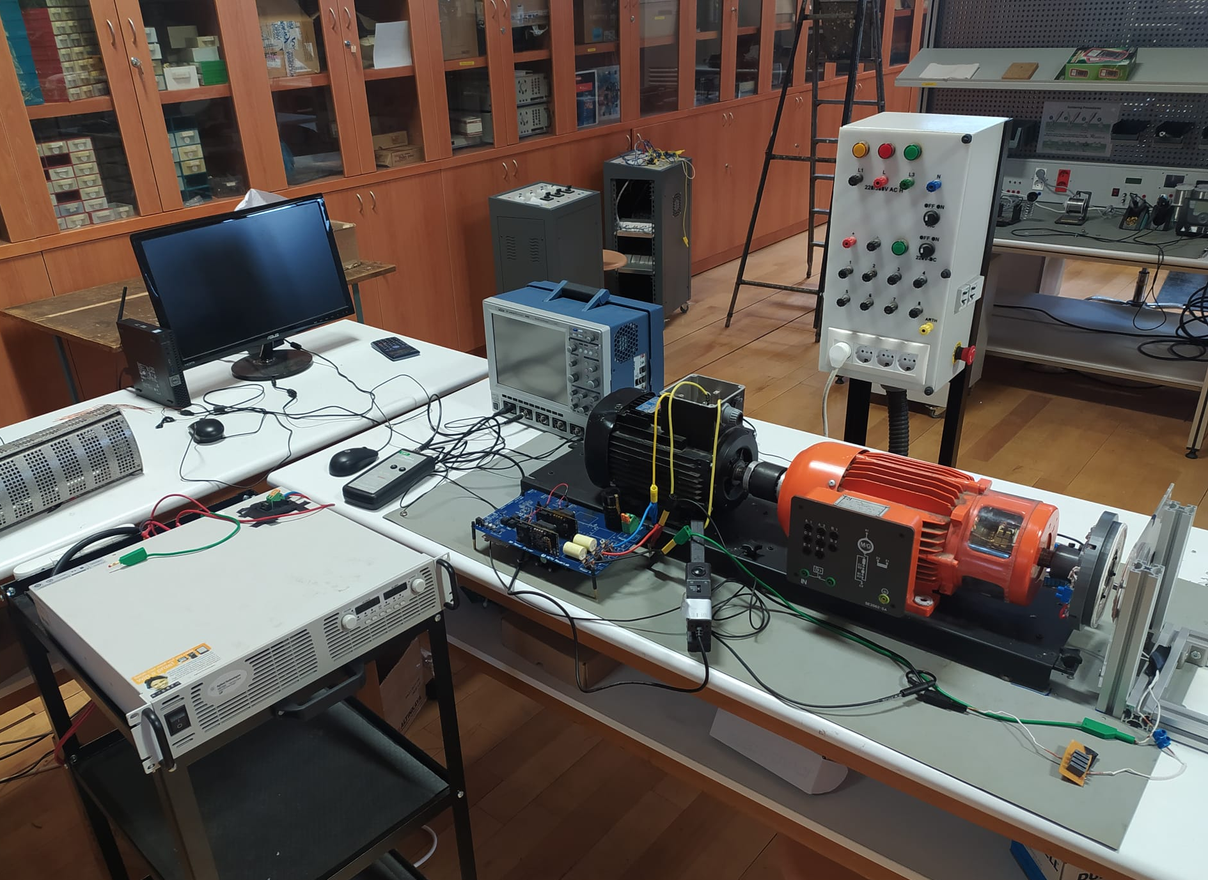
Oscilloscope
AC motor
Rotating
Rx
Stationary
Tx
DC supply
Inverter
Load (DC motor)

